Slide 1

These things we also speak, not in words which man’s wisdom teaches but which the Holy Spirit teaches, comparing spiritual things with spiritual (1 Cor. 2:13).
All Scripture is taken from the New King James Version®. © 1982 by Thomas Nelson, Inc. Used by permission. All rights reserved.
Spiritual Terms Evaluation

Slide 2
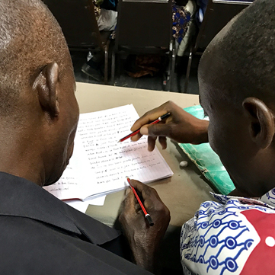

In Step 7, key words were chosen for each chapter.
Now an assigned list of terms will be evaluated across the whole New Testament.

Slide 3
What kinds of terms?
Abstract meaning
Spiritual
meaning
tree
adoption
flesh

Slide 4
?
Why check words across the whole New Testament?
Different translators
Same
words?

Slide 5
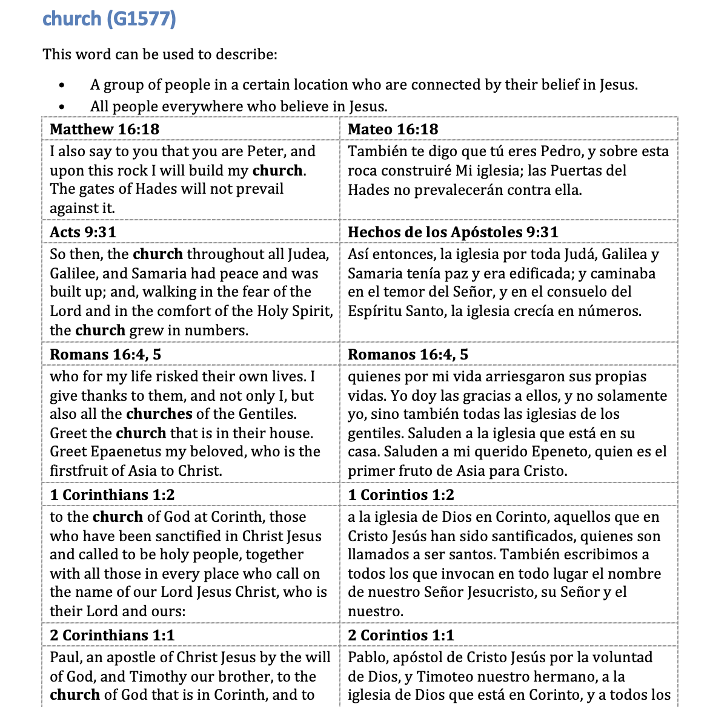



Slide 6
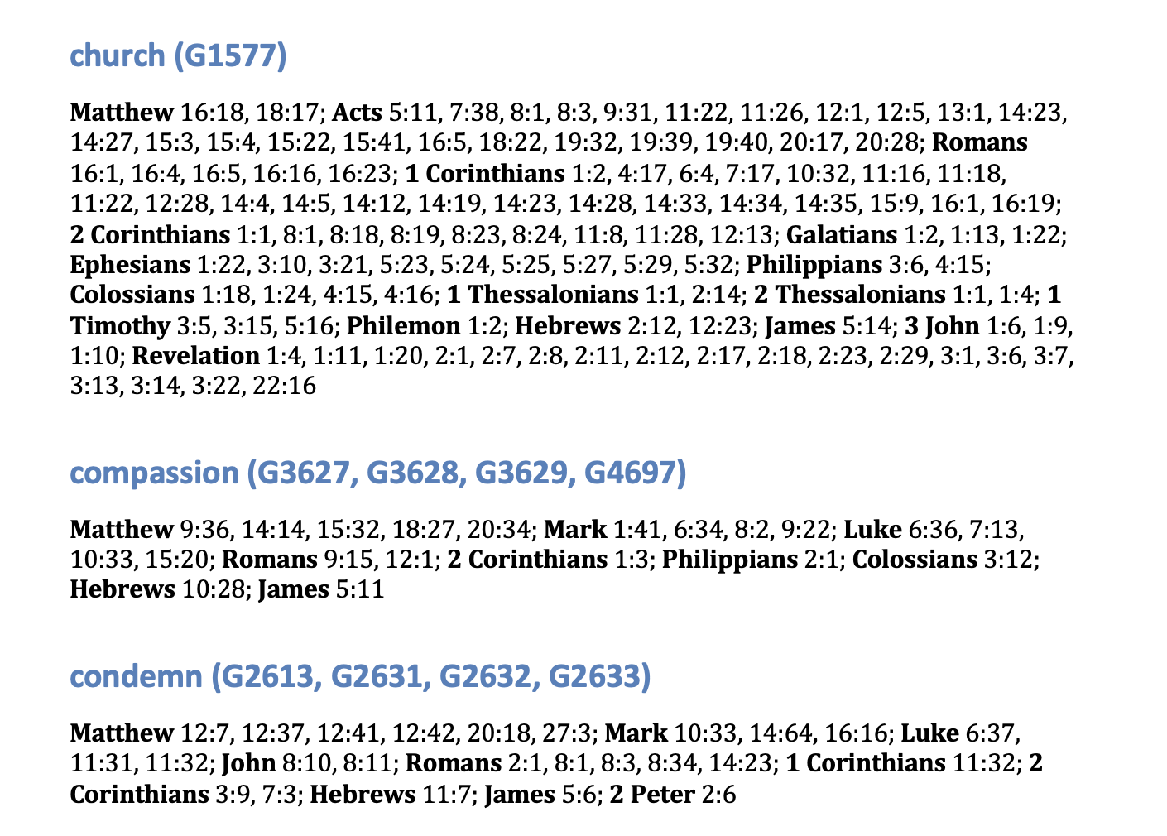

Slide 7
Try it

Slide 8
?
Consistency?
Correct meanings?
Changes?

